Slide 1
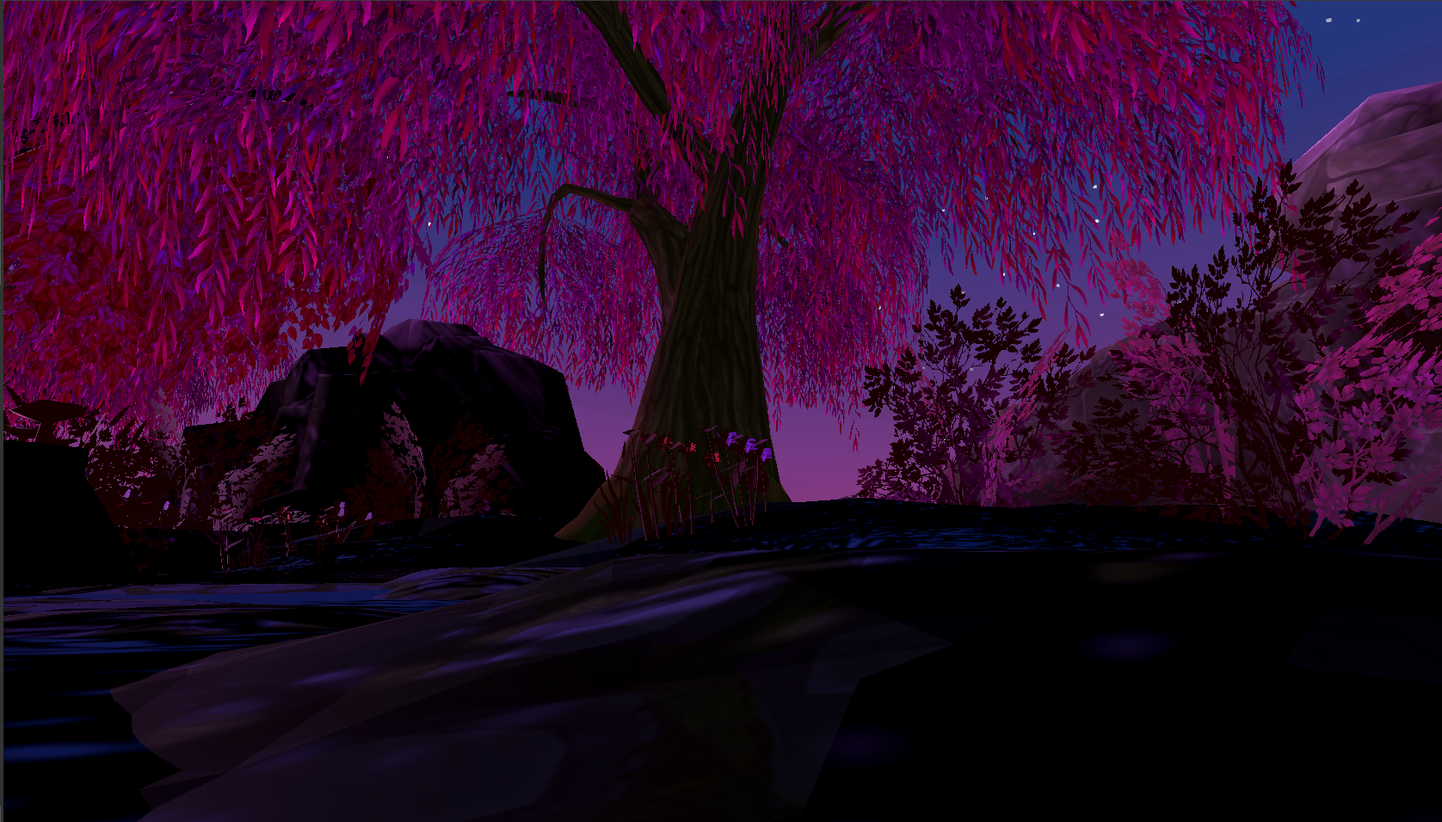
Endless Dreamer
by Diana Sandu

Slide 2
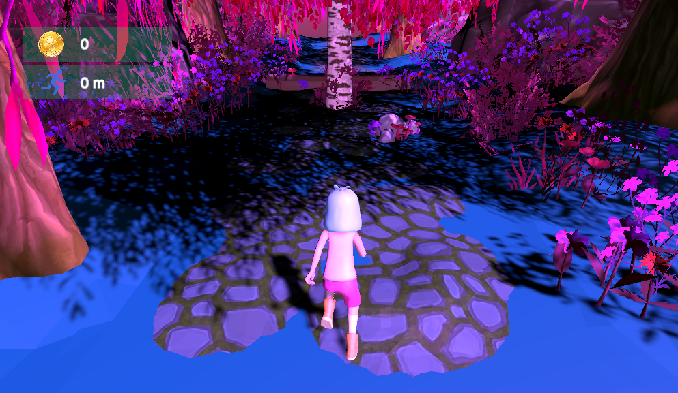
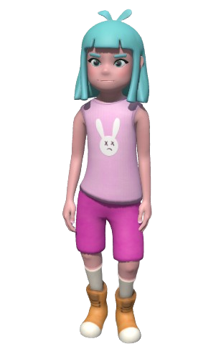
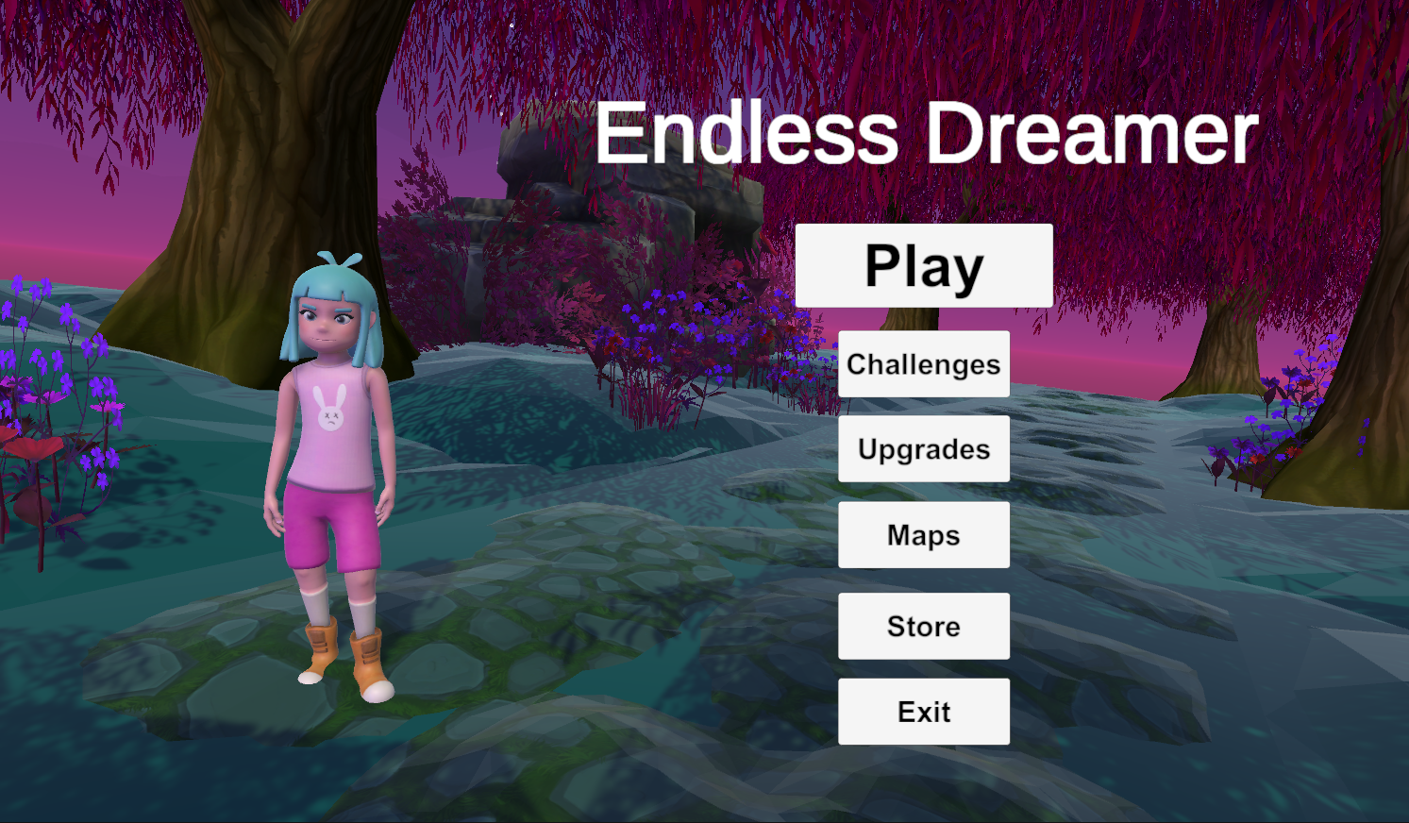
The Pitch
Run through different dreams, collecting coins and power-ups, and levelling up your character
An endless runner, where you run through different dream relms, collecting coins and powerups and levelling up your character
Add similar to slide?
Screen record the char https://www.mixamo.com/#/?page=1&query=&type=Motion%2CMotionPack , make it a git and put it in https://onlinegiftools.com/create-transparent-gif
What is Endless Dreamer ?
An Endless Runner

Slide 3
The Pitch
Run through different dreams, collecting coins and power-ups, and levelling up your character
An endless runner, where you run through different dream relms, collecting coins and powerups and levelling up your character
Add similar to slide?
Screen record the char https://www.mixamo.com/#/?page=1&query=&type=Motion%2CMotionPack , make it a git and put it in https://onlinegiftools.com/create-transparent-gif
Gameplay Sneak Peek

Slide 4

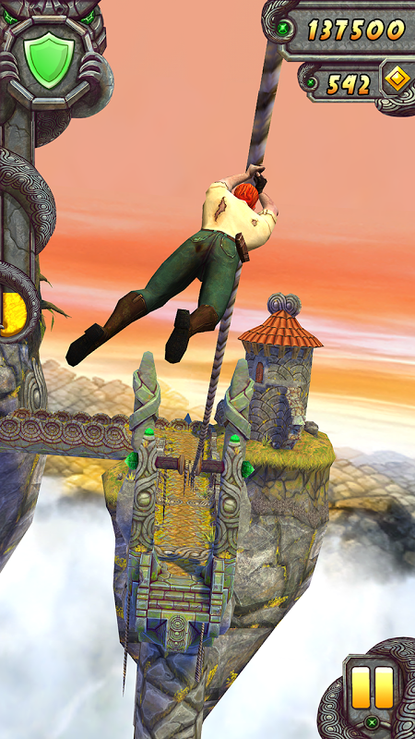

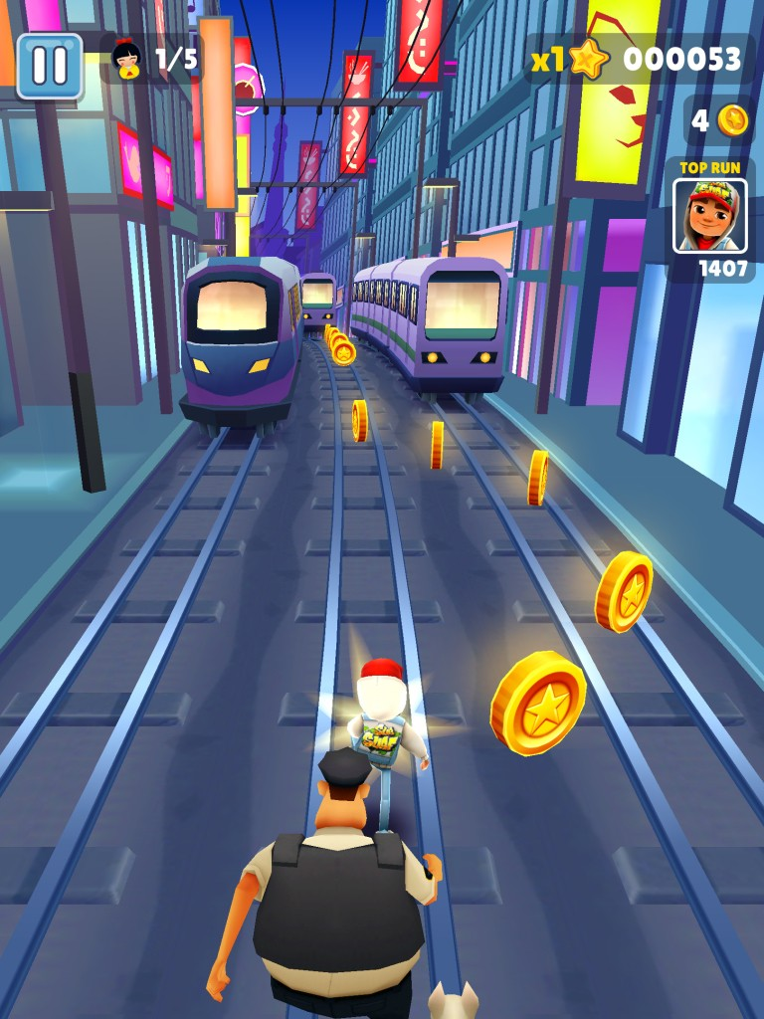
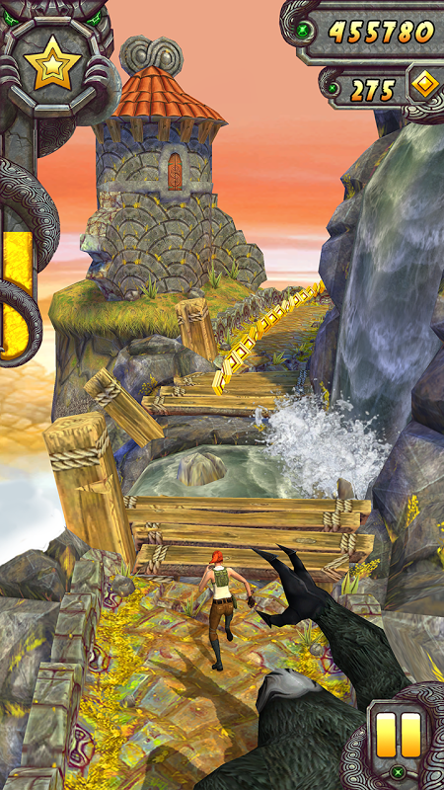

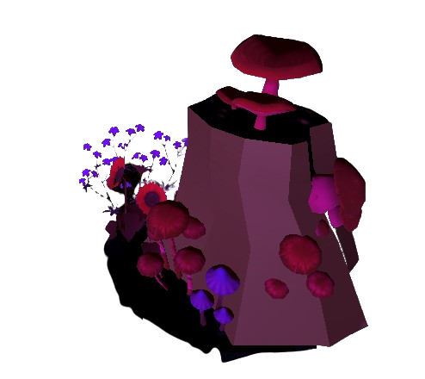
The Pitch
Inspired By
Run through different dreams, collecting coins and power-ups, and levelling up your character
An endless runner, where you run through different dream relms, collecting coins and powerups and levelling up your character
Add similar to slide?
Screen record the char https://www.mixamo.com/#/?page=1&query=&type=Motion%2CMotionPack , make it a git and put it in https://onlinegiftools.com/create-transparent-gif

Slide 5
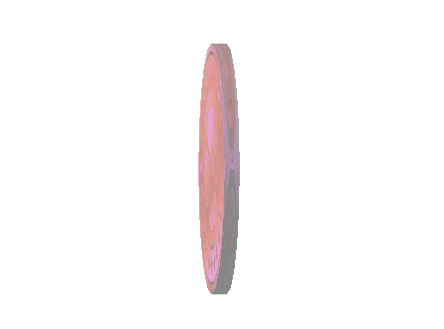

Gameplay Loop
Endless Dreamer is an endless runner game available on both PC and mobile.
Explore the different dreams, ( level up your character), collect coins to upgrade available powerups and doge debuffs ad obstacles to avoid waking up.
Get new highs cores running further and faster using draftable potions and climb the leaderboards
Make it shorter and add gameplay ss
Endless runner
Collect coins & powerups
Dogde debuffs & obstacles
New highscores

Slide 6
Additional features
Features:
High score separate from the distance ran
Quests/objectives
Achievements
Unlockable and purchasable characters and maps
Make an example scene with a standard background and a levelup bar under the chaaracter
More maps
More characters
Quests
Achievements
Dogde debuffs & obstacles
New highscores

Slide 7
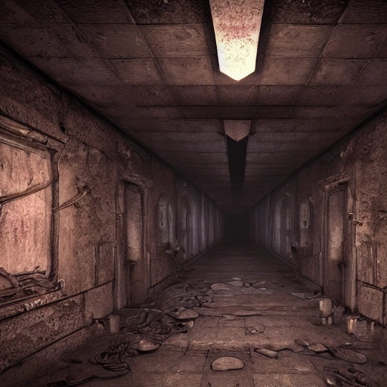
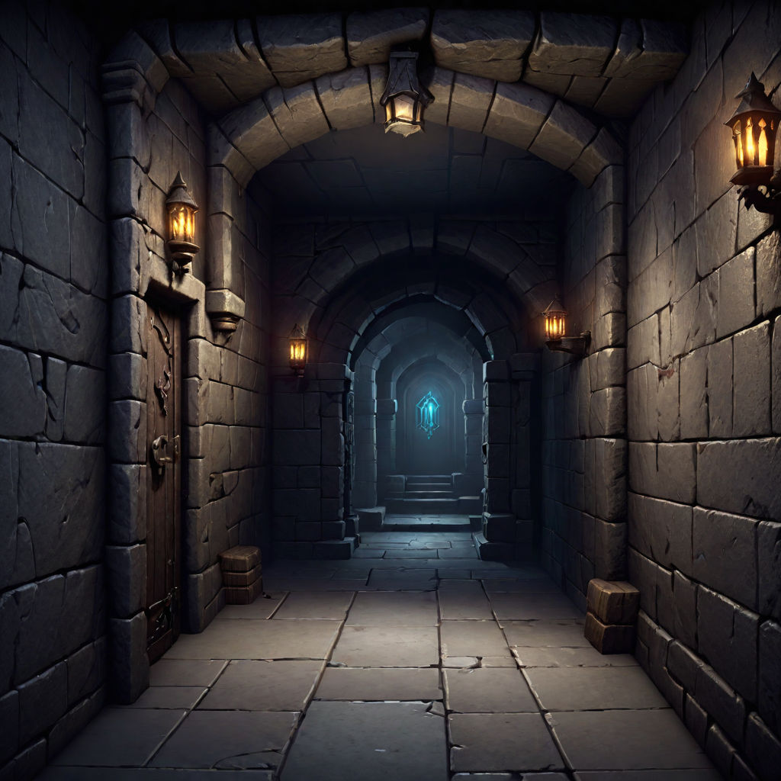

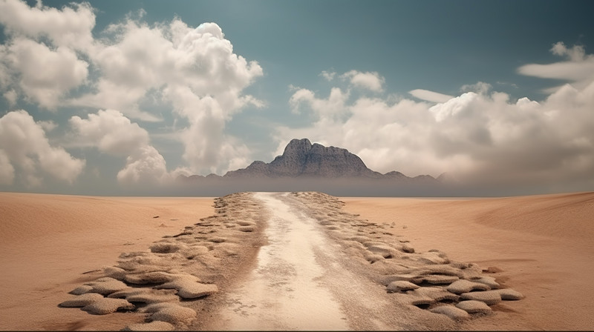
Additional Maps Concept art

Slide 8

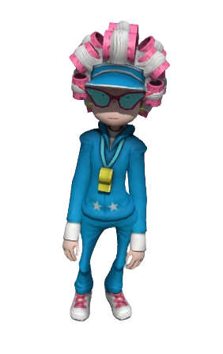

Additional Character Models

Slide 9



Unique features
(you might think this is just another endless runner clone from the market)
More features (new slide?)
Level up your character and their unique ability
Craft system
Level up your character and their unique ability
Craft system

Slide 10
Timeline and funding
~ 3 months
2500€ / month
hi, im diana and this my new upcoming game endless dreamer
we dont have a lot of time, so i'll get straigh to it, what is endless dreamer? well it's an endless runner, where you run through dreams. collecting coins and powerups and leveling your character.
this is what the early development stages look like so far
The game is inspired by the endless runners of my childhood, temple run and subway surfers (photoes)
What will the game play loop look like?
like mensioned befoer, the player runs through dreams, collect coins and upgrade the powerups that can be found for further and further runs each time similar to temple run
aditional features
the further the player runs, the higher the score to show off to your friends.
verious quests to complete to gain rewards
unlockable achievements
more maps/dreams to explore and characters to level both unlockable and purchesable form the store
and now u might be wondering, why play this when there are others already out with more cosmetics, more players and more attention?
well my game also gives you the ability to level up your characters, with unique features unlockable at higher levels
There will be a crafting system for potions that can give you extra lives, or multipliers for yout score
Now for the funding

Slide 11
Thank you

